Slide 1
Troy Magennis (@t_magennis) Risk: The Final Enterprise Frontier

Slide 2
Risk: The Final Agile Frontier
Troy Magennis
@t_magennis
Troy.Magennis@focusedobjective.com

Slide 3
Slides, Forecasting Spreadsheets, Resources
Bit.Ly/SimResources
(case sensitive)
And live tweets direct to material here
@t_magennis

Slide 4


Slide 5
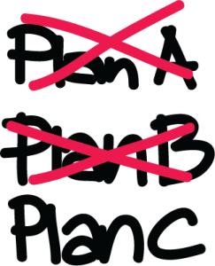

Slide 6
Definition: Risk
Anything that causes actual outcome to be different than the planned outcome.

Slide 7


Slide 8


Slide 9
Definition: Risk
Anything that causes actual outcome to be different than the planned expected or desired outcome.

Slide 10
Nirvana
Staff driven
Cost driven
Risk driven
Flexible
Ability to alter investment once committed
Fixed
Low Loss
High Loss
Penalty of being late – lost revenue, etc.
Notes:
Ability to alter budget or investment once committed
Upfront costs to start the project/feature
Penalty of being late or not knowing early enough

Slide 11
Risk #1

Slide 12
Network Throughput Test
Slides and spreadsheets at
Bit.ly/SimResources
(Case SENSITIVE)

Slide 13
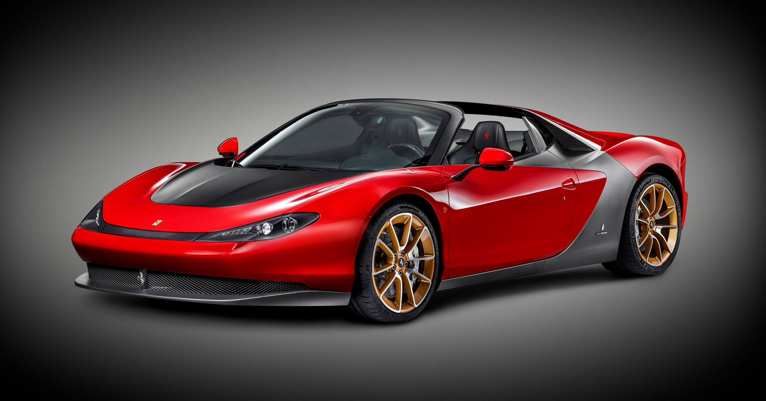

Slide 14


Slide 15
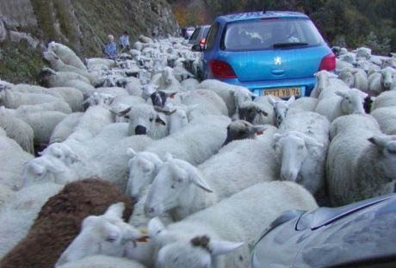

Slide 16
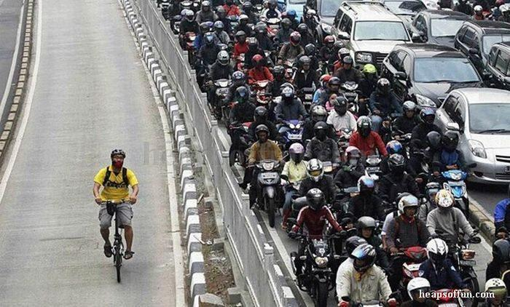

Slide 17
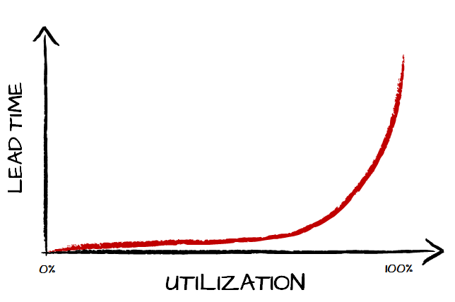
Item Estimation “always” Fails
How much does item size (estimates) play a role in lead time?
Item Estimation “may” work
See full story at http://brodzinski.com/2015/01/slack-time-value.html

Slide 18
Can’t forecast high utilization systems using item size
Trucks move at same speed as cars

Slide 19
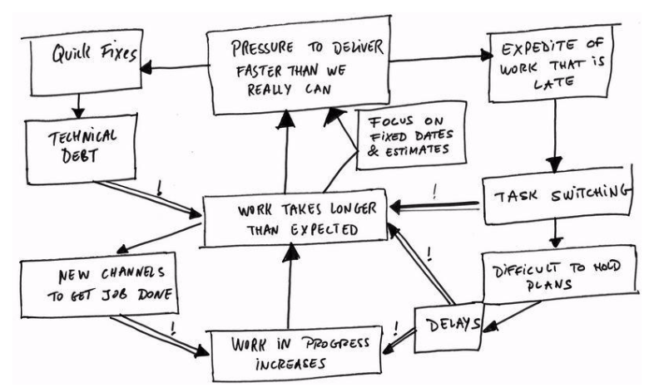
Brilliant!

Slide 20

For high utilization systems we need to track/manage system level impediments
“Things that impact EVERY item”
“System Utilization”

Slide 21
Traditional risk management

Slide 22
PMBOK v5 Six-Step Risk Process
Plan Risk Management
the process of defining how to conduct risk management activities for a project.
Identify Risks
The process of determining which risks may affect the project and documenting their characteristics.
Perform Qualitative Risk Analysis
The process of prioritizing risks for further analysis or action by assessing and combining their probability of occurrence and impact.
Perform Quantitative Risk Analysis
The process of numerically analyzing the effect of identified risks on overall project objectives.
Plan Risk Responses
The process of developing options and actions to enhance opportunities and to reduce threats to project objectives.
Control Risks
The process of implementing risk response plans, tracking identified risks, monitoring residual risks, identifying new risks, and evaluating risk process

Slide 23
Prince 2 Five-Step Risk Process
Step 1 – Identify
Tailor a risk management strategy for the project and identify the risks including both threats and opportunities.
Step 2 – Assess
for each risk identified estimate the probability, impact and proximity. Evaluate the overall risk exposure of the project.
Step 3 – Plan
plan the risk responses. Electing to Avoid, Share, Reduce, Accept, Fallback (contingent action) or Transfer risks(threats) and Share, Enhance, Exploit, or Reject Opportunities
Step 4 – Implement
Manage, control and report on the risks and their risk management progress.
Step 5 – Communicate
continuously communicate the risks and their status to project stakeholders.

Slide 24
Risk Matrix | Low Likelihood (1) | Medium Likelihood (2) | High Likelihood (3)
High Impact (3) | 3 | 6 | 9
Medium Impact (2) | 2 | 4 | 6
Low Impact (1) | 1 | 2 | 3

Slide 25
Risk x Impact = Irrelevant
50% Chance of a 1 month delay
Probability x Impact = 0.5 x 1 month = 2 weeks
NO!

Slide 26
Risk x Impact = Irrelevant
Probability
1
Date

Slide 27
Risk x Impact = Irrelevant
50% Outcomes
50% Outcomes
Probability
1
2
Date

Slide 28
risk events – nothing goes wrong
Probability
1
Date

Slide 29
risk events – 1 delay comes true
Probability
1
2
3
Date

Slide 30
risk events – 1 delay 25% chance
75% Outcomes
25% Outcomes
Probability
1
2
3
Date

Slide 31
risk events – 2 delays @ 25% chance
~ 57 % Outcomes
~36% Outcomes
6.25% Outcomes
No Delays!
Either Delay!
Both Delays!
Probability
1
2
3
Date

Slide 32
risk events – 3 delays @ 25% chance
Work | Del 1 | Del 2 | Del 3
1 | 0 | 0 | 0 | 1
1 | 0 | 0 | 1 | 2
1 | 0 | 1 | 0 | 2
1 | 0 | 1 | 1 | 3
1 | 1 | 0 | 0 | 2
1 | 1 | 0 | 1 | 3
1 | 1 | 1 | 0 | 3
1 | 1 | 1 | 1 | 4
Probability
1
2
3
4
Date

Slide 33
risk events – 4 delays @ 25% chance
By 4 delays @ 25%, its more likely at least one delay occurs versus none!
Probability
1
2
3
4
5
Date

Slide 34
What is the planned, expected, desired date
What assumptions have we made in passively or actively agreeing to that date
What factors could influence or block progress

Slide 35
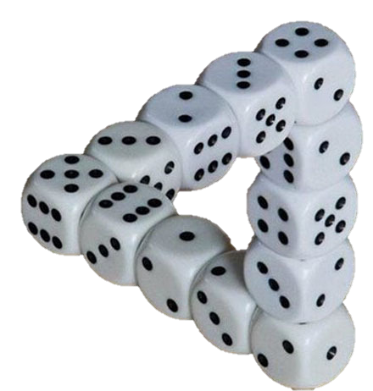
Technical Risk
Real Options
Right Staff / liquidity
Dev Practices
Dependencies
Constraints
Financial Risk
Having funding/cash
Having a strategy
Economic prioritization
Real Options
Market Risk
Lean Startup
Agile Processes
Competitive Awareness
“Aleatory Risk”
Cannot be reduce by more info

Slide 36
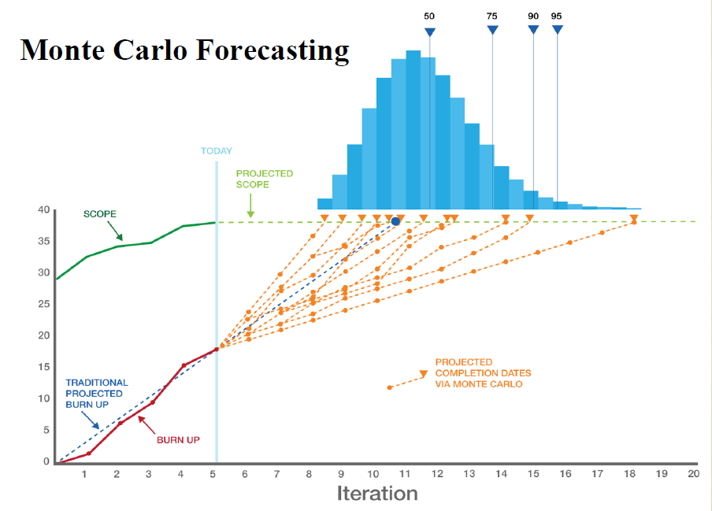

Image thanks to Larry Maccherone

Slide 37
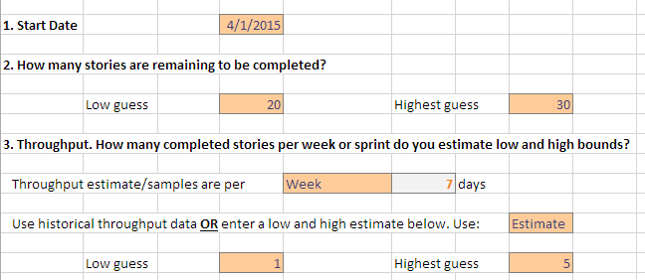
What is this chart?
This chart shows the simulated burn-down trends. It shows the first 50 trials and visually shows the general hotspots and outlier dates.
Bit.ly\SimResources

Slide 38
Viability (go/no go)
Ability to start
Multiple teams
Team
Story

Slide 39
Things that impact viability or necessity (go/no-go decisions)
Things that inhibit starting at all (on paper starts)
Things that impact multiple teams (organizational dependencies)
Things that impact every story (system)
Things that impact majority stories (frequent)
Things that impact a single story (local)

Slide 40

Ten #Failed Forecasting Plan Assumptions
By Troy Magennis
@t_magennis
FocusedObjective.com

Slide 41


1: Missed Start Date
Mistake when planning portfolios

Slide 42
1: Missed Start Date Actual Start Date > Planned Start
Planned Start
Actual Start
December
January
February
March
2 Month Delay
Decision Delay

Slide 43
1: Missed Start Date Actual Start Date > Planned Start
How the planned date was chosen?
Who signs off on the decision to do this project?
Causes of past delays?
Possible delays of this project?
Give estimates as duration rather than end-date
Keep history of planned date versus start date delay
Model start date risk using the historical range of delays

Slide 44
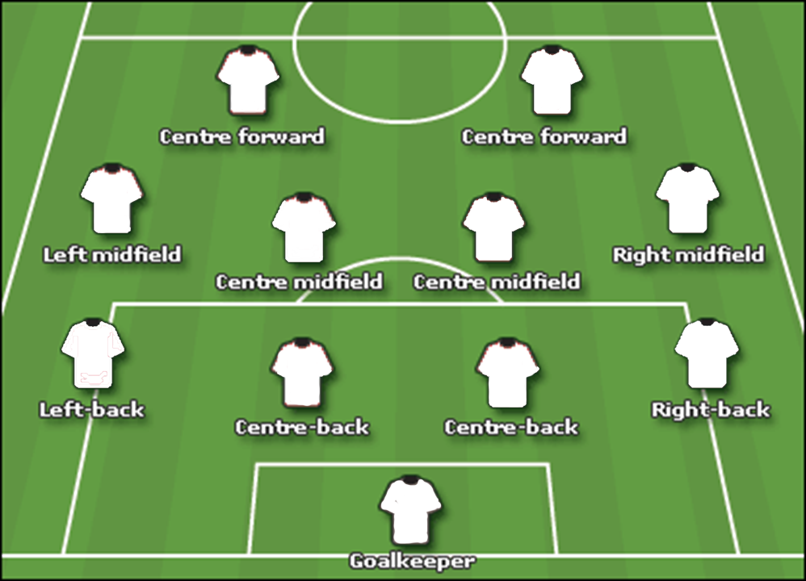
2: No Team (Team not ready)

Slide 45
2: Team Not “Ready” at Start Date Actual Team = 0
Planned Start
Possible Start
Actual Start
December
January
February
March
3 Month Delay
Team Delay

Slide 46
2: Team Not “Ready” at Start Date Actual Team = 0
Is the team in place already? Can I see them?
What are they working on now? Is it likely to be delayed?
Higher priority projects?
Plans to hire aren’t always achievable by given date
Plan environment factors: space to sit, equipment, meeting space
What infrastructure does the team need to “start” work?

Slide 47
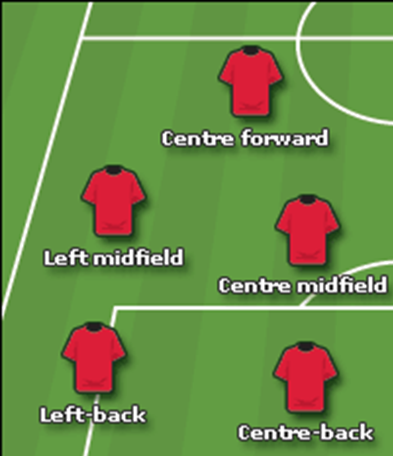

3: Partial Team (Team < planned)

Slide 48
3: Team Not at Strength Actual Team < Planned Team
Planned Start
Possible Start
Actual Start
December
January
February
March
3 Month Delay
Team Delay

Slide 49
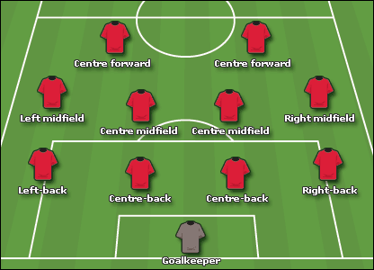


4: Partial Body Staffing

Slide 50
4: Partial Body Staffing Actual Team “sometimes =” Planned
Planned Start
Possible Start
Oops!
Track interruptions
December
January
February
March
Team Delay

Slide 51
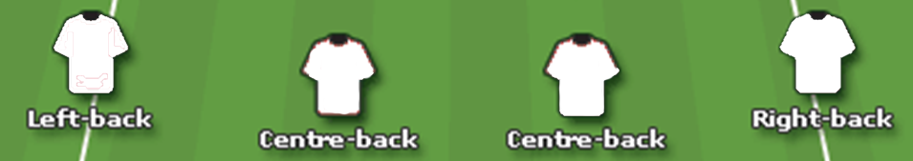
5: Missing Skillsets

Slide 52
5: Team Does Not Have Needed Skills Actual set(skills) < planned set(skills)
Planned Start
Possible Start
Full Strength!
December
January
February
March
CSS / JavaScript
Java / C#
Team Delay

Slide 53
3, 4 & 5: Team Skill and Strength
How were the skill-sets required determined
Did skill level factor into team planning
What other duties do the planned staff perform (production support, etc.)
How ramp up time for new members is considered
Plan what skills are necessary for the project
Perform Capability Matrix to find skill gaps and resolve
Estimate and plan how long it takes from “hire to productive” for skills
Only plan using “productive date” (not the hire date)

Slide 54
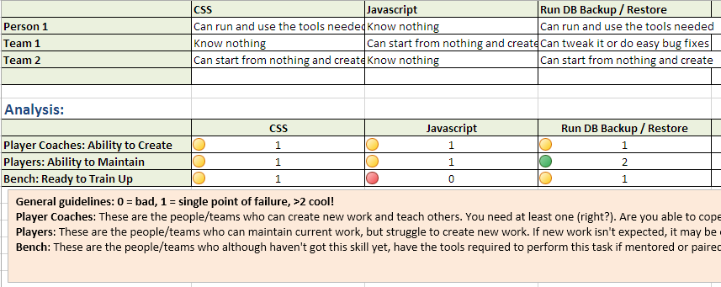
Capability Matrix

Slide 55

Amdahl's Law indicates that the speedup from parallelizing any computing problem is inherently limited by the presence of serial (non-parallelizable) portions

Slide 56
6: Overstating Parallel Scalability
6: Overstated Parallel Effectiveness
Amdahl's Law indicates that the speedup from parallelizing any computing problem is inherently limited by the presence of serial (non-parallelizable) portions
Team 1
Team 2
Idea
Planning / Pre “Go” Decision
Integration / Distribution
Customer
Team 3
Team n
Serial
Parallel
Serial

Slide 57
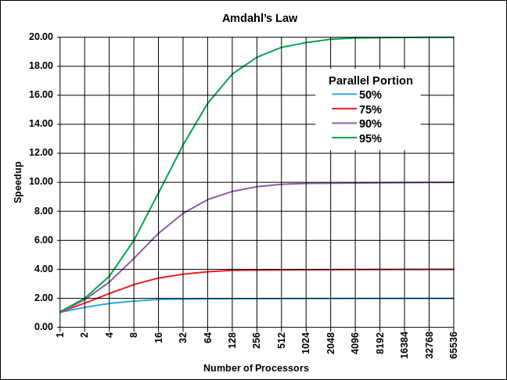
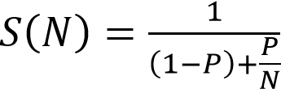
6: Overstated Parallel Effectiveness
6: Overstated Parallel Effectiveness
8 parallel teams with 75% parallelizable work = 3x

Slide 58
6: Overstating Parallel Scalability Actual Benefit < Assumed Benefit
What are the serial parts of a complete system path (often shared resources)
How do teams plan to integrate work
How do team co-ordinate and plan work
What are the inter-dependencies between teams
Find ways to eliminate serial paths
Track and prioritize fixing blockers in serial paths
Organize teams to reduce inter-dependencies
Remind people non-linearity of parallel scaling

Slide 59

7: Dependencies and Friction
Amdahl was an Optimist
Error for high team count

Slide 60
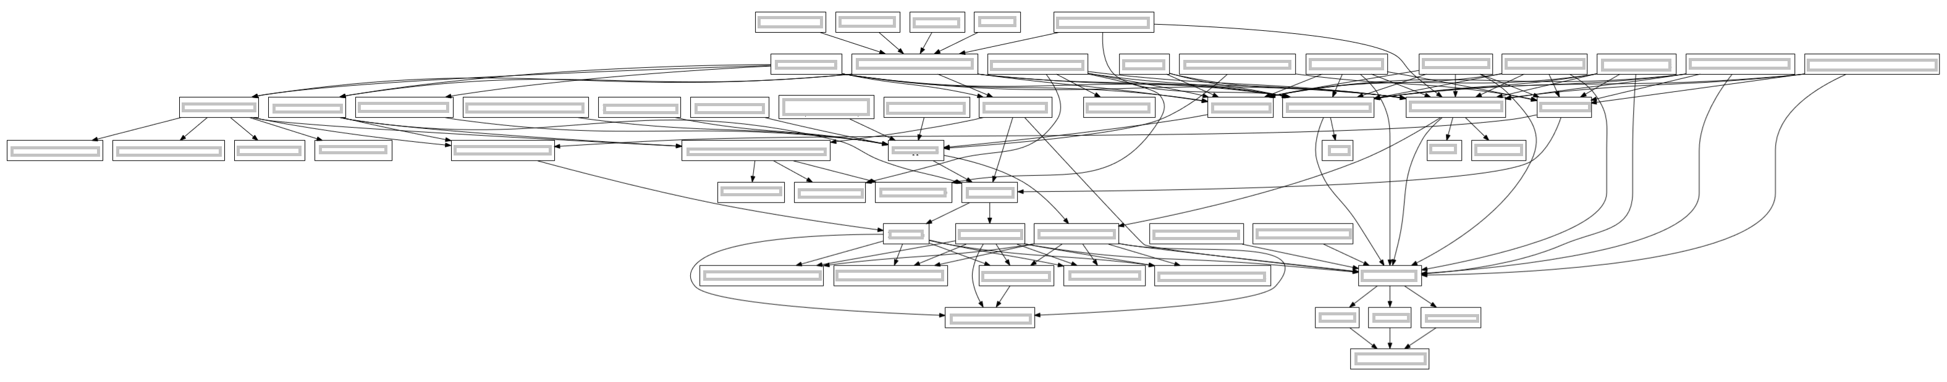
1
2
3
4
5
6
7
Team Dependency Diagram

Slide 61
Chances at least one team not delayed
1 in 2^{n} ^{or}
1 in 2⁷
^{or}
1 in 128

Slide 62
7 dependencies
1 chance in 128

Slide 63
6 dependencies
1 chance in 64

Slide 64
5 dependencies
1 chance in 32

Slide 65
7: Dependency Impacts Your timetable != Someone else’s
Determine complexity in build order dependencies
Determine is-aligned priorities
Determine what incentives are in place
Look for re-organization opportunities to reduce dependencies
Reduce batch sizes
Communicate initial and updated information often
Build incentives to align priorities

Slide 66

Defects
Technical Debt
Mistake for startups & older systems
8: Carried over defects and debt

Slide 67

9: Ship Stoppers

Slide 68
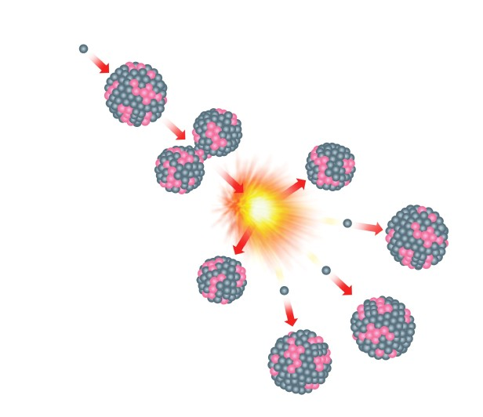
10: Splitting
Product Backlog
Mistake when forecasting using data
Historical throughput/velocity based on pre and post split work
Sprint Backlog

Slide 69


Forecast
Assumption 1
Assumption 2
Assumption 3
Assumption …
Assumption n

Slide 70




Calls to action…
Understand when estimation is NOT needed
Track failed assumptions not work item status
Build achievable plans and goals
Free tools / Spreadsheets / Exercises Bit.ly/SimResources
Twitter: @t_magennis
Email: troy.magennis@focusedobjective.com

Slide 71
Troy Magennis (@t_magennis) Entangled: Solving the Hairy Problem of Team Dependencies

Slide 72
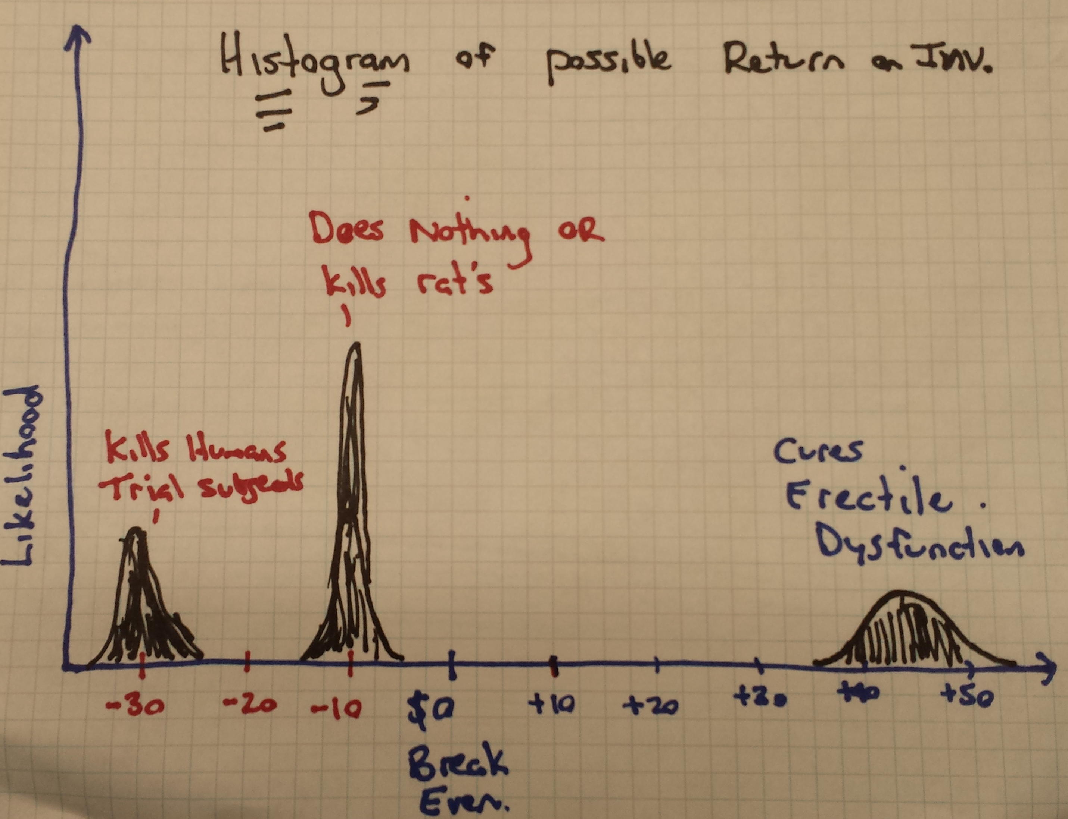



Slide 73
risk events
Nothing Goes Wrong
Performance OR Vendor Delay
Performance AND Vendor Delay
Probability
1
2
3
Time

Slide 74
Delay
(Technical Risk)
Low Adoption
(Market Risk)
Low Cashflow
(Financial Risk)
Less Resources
(Financial Risk)
Risk Positive Feedback
Loop

Slide 75
Key Point
Occurrence of a risk Increases exposure to other risks
Break the chain early

Slide 76
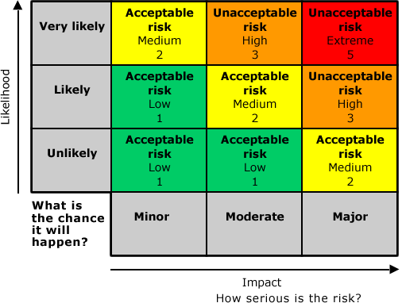

Slide 77
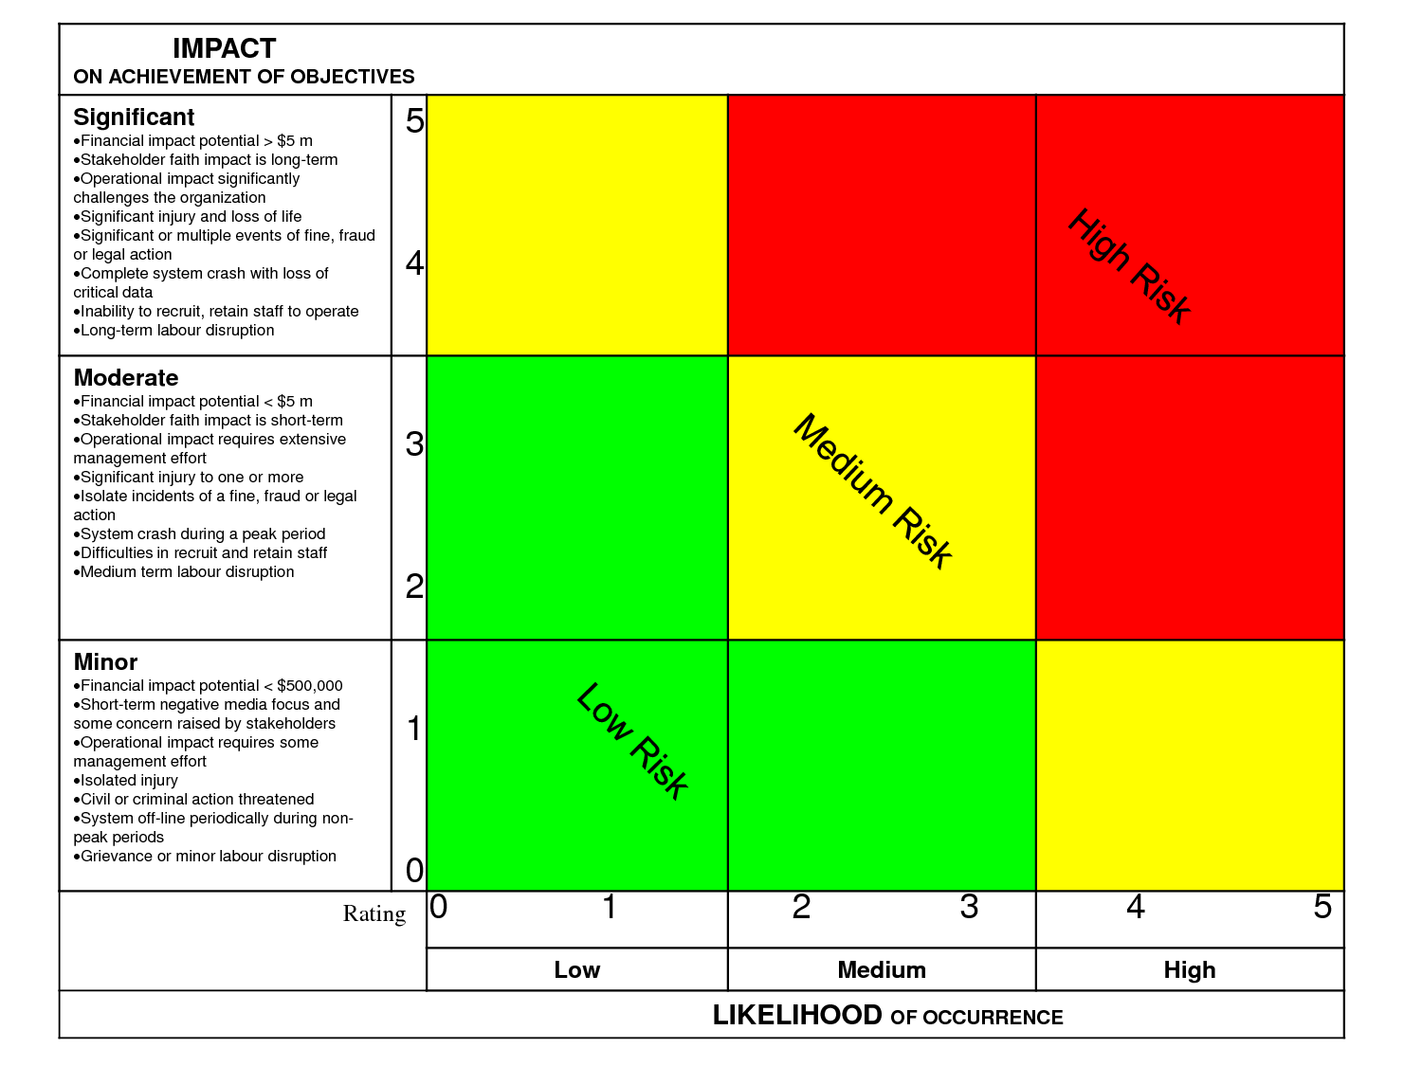

Slide 78
Team 1 | Team 2 | Team 3 | Team 4
0 | 0 | 0 | 0
0 | 0 | 0 | 0.75
0 | 0 | 1 | 0
0 | 0 | 1 | 0.75
0 | 0.25 | 0 | 0
0 | 0.25 | 0 | 0.75
0 | 0.25 | 1 | 0
0 | 0.25 | 1 | 0.75
1 | 0 | 0 | 0
1 | 0 | 0 | 0.75
1 | 0 | 1 | 0
1 | 0 | 1 | 0.75
1 | 0.25 | 0 | 0
1 | 0.25 | 0 | 0.75
1 | 0.25 | 1 | 0
1 | 0.25 | 1 | 0.75
Week 1
0
0.75
1
1.75
0.25
1
1.25
2
1
1.75
2
2.75
1.25
2
2.25
3
24

Slide 79
Capture Expectations
Develop Plan
Detect/Predict Deviation
Apply Remedy
Do the plan

Slide 80
The shape of cycle time
What distribution fits cycle time data and why…

Slide 81
If we understand how cycle time is statistically distributed, then an initial guess of maximum allows an inference to be made
Alternatives -
Borrow a similar project’s data
Borrow industry data
Fake it until you make it… (AKA guess range)

Slide 82
Why Weibull
Now for some Math – I know, I’m excited too!
Simple Model
All units of work between 1 and 3 days
A unit of work can be a task, story, feature, project
Base Scope of 50 units of work – Always Normal
5 Delays / Risks, each with
25% Likelihood of occurring
10 units of work (same as 20% scope increase each)

Slide 83
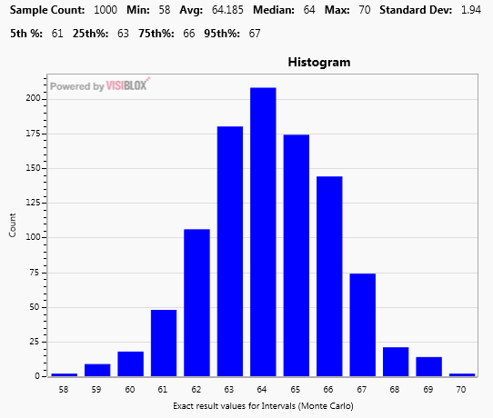
Normal, or it will be after a few thousand more simulations

Slide 84
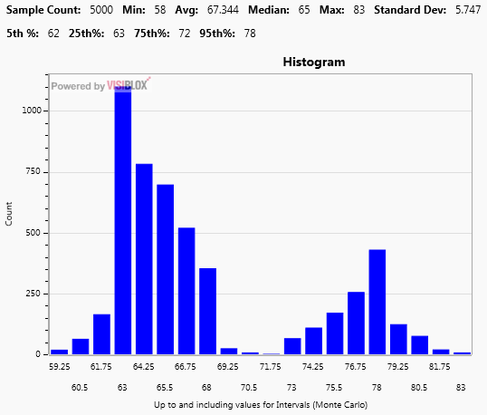
Base + 1 Delay

Slide 85
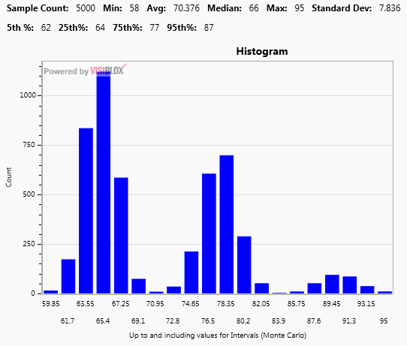
Base + 2 Delays

Slide 86
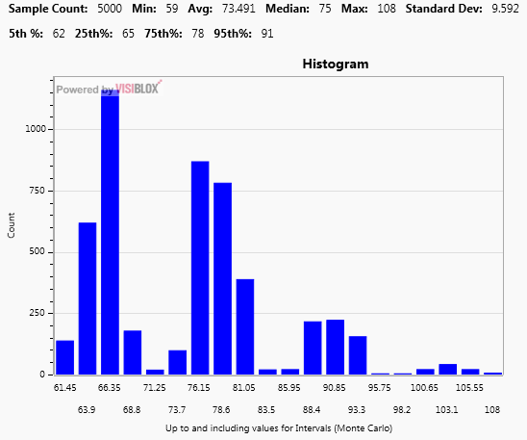
Base + 3 Delays

Slide 87
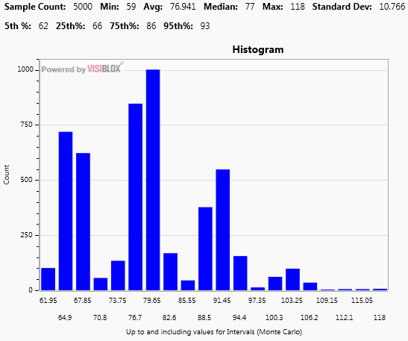
Base + 4 Delays

Slide 88
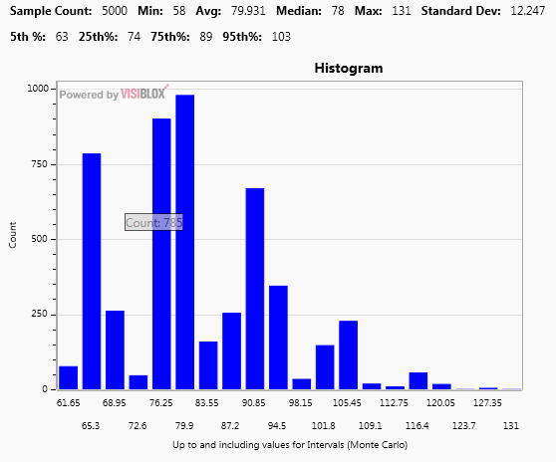
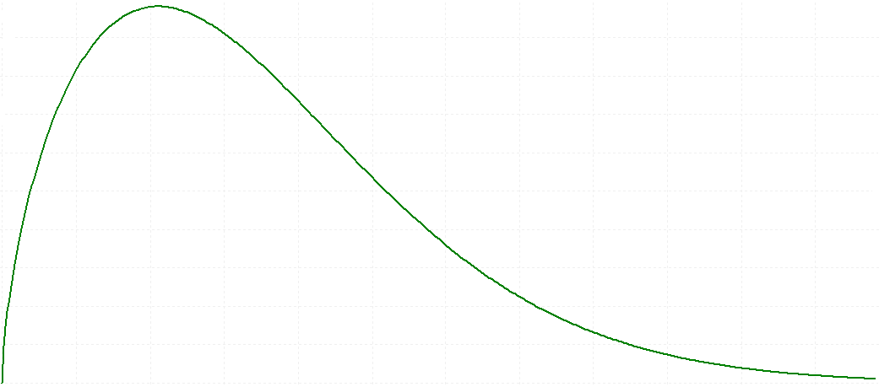
Base + 5 Delays

Slide 89
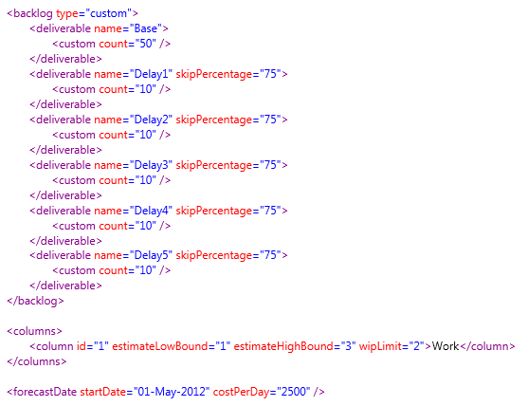

Slide 90
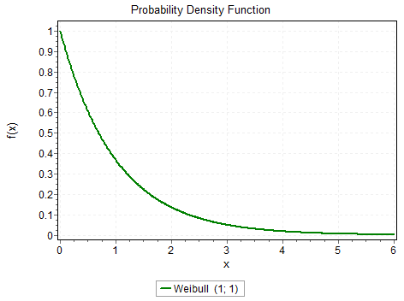
Exponential Distribution (Weibull shape = 1)
The person who gets the work can complete the work
Teams with no external dependencies
Teams doing repetitive work E.g. DevOps, Database teams,

Slide 91
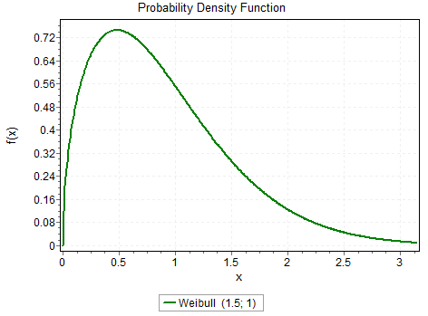
Weibull Distribution (shape = 1.5)
Typical dev team ranges between 1.2 and 1.8

Slide 92
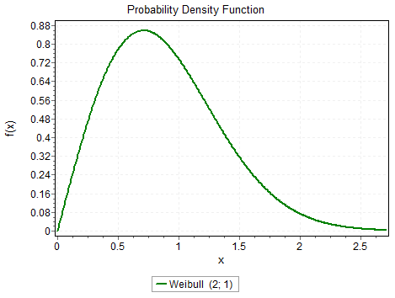
Rayleigh Distribution (Weibull shape = 2)
Teams with MANY external dependencies
Teams that have many delays and re-work. E.g. Test teams

Slide 93
What Distribution To Use...
No Data at All, or Less than < 11 Samples (why 11?)
Uniform Range with Boundaries Guessed (safest)
Weibull Range with Boundaries Guessed (likely)
11 to 30 Samples
Uniform Range with Boundaries at 5th and 95th CI
Weibull Range with Boundaries at 5th and 95th CI
More than 30 Samples
Use historical data as bootstrap reference
Curve Fitting software

Slide 94
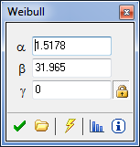
Shape – How Fat the distribution. 1.5 is a good starting point.
Scale – How Wide in Range. Related to the Upper Bound. *Rough* Guess: (High – Low) / 4
Location – The Lower Bound

Slide 95

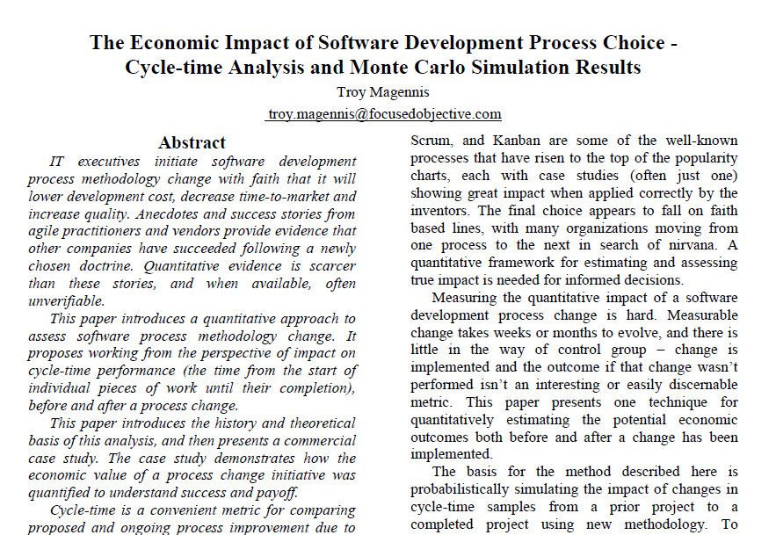

Slide 96


1997: Industrial Strength Software
by Lawrence H. Putnam , IEEE , Ware Myers
2002: Metrics and Models in Software Quality Engineering (2nd Edition) [Hardcover]
Stephen H. Kan (Author)
Paper: http://bit.ly/14eYFM2

Slide 97
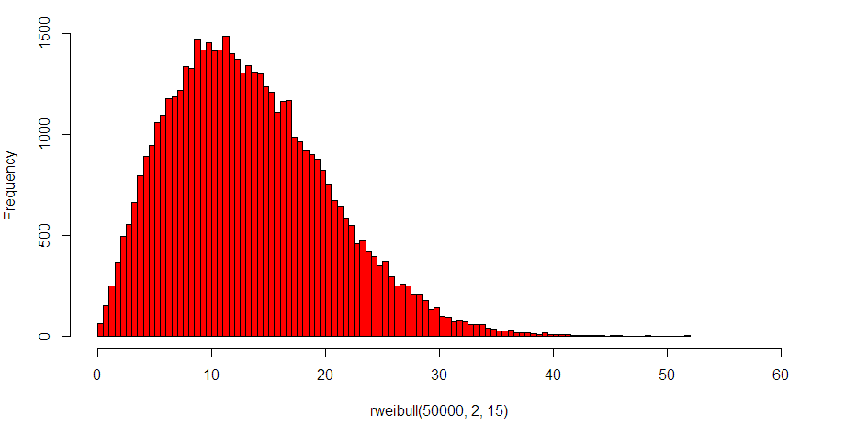
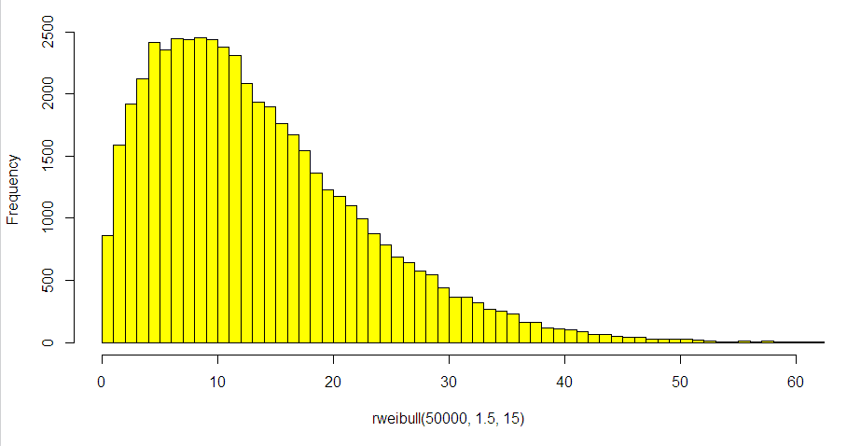
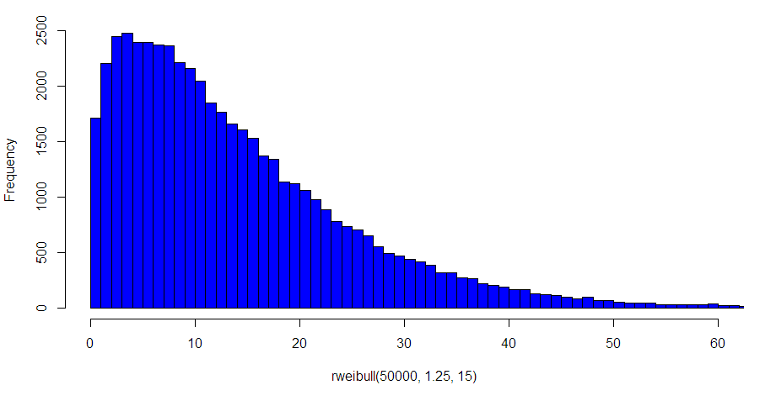
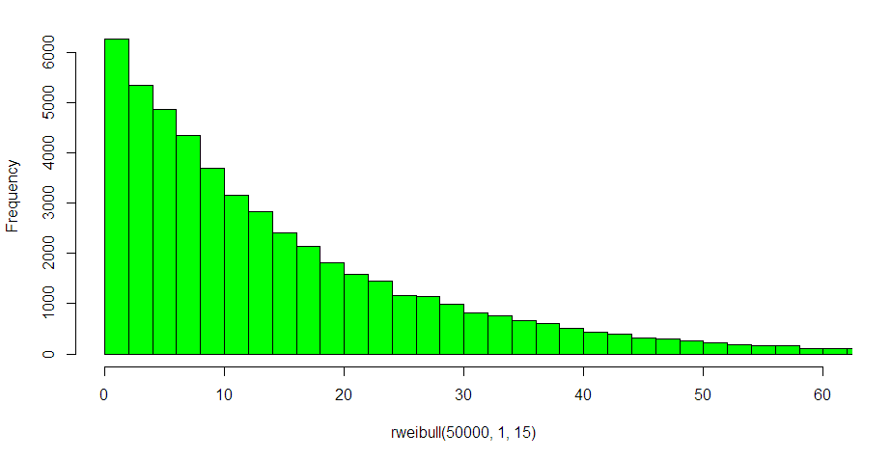
1970-1990’s
Waterfall
Rayleigh Distribution, Weibull shape parameter = 2
Approx 2000
Weibull shape parameter = 1.5
Approx. 2008
Lean
Weibull shape parameter = 1.25
Approx 2010
Exponential Distribution, Weibull shape parameter = 1
Cycle Time in Days
Work Item Cycle Time or Lead Time Distribution Through the Ages
Paper: http://bit.ly/14eYFM2

Slide 98
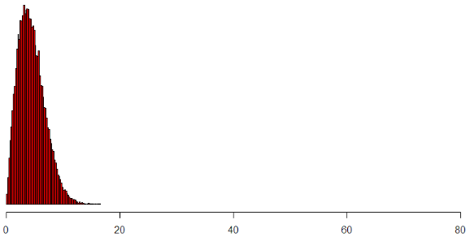
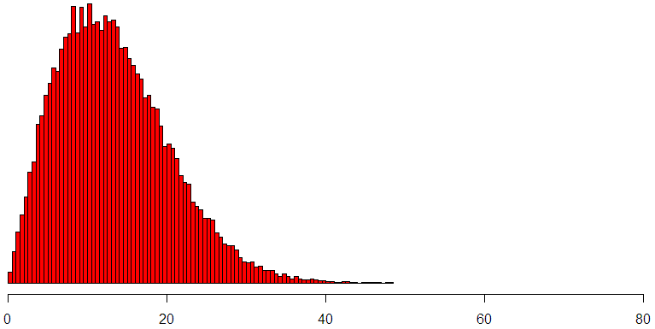
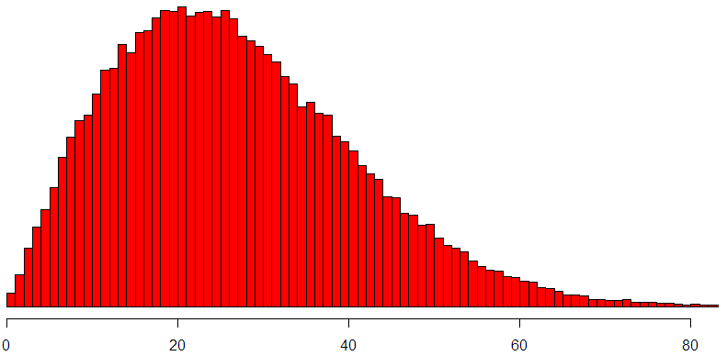
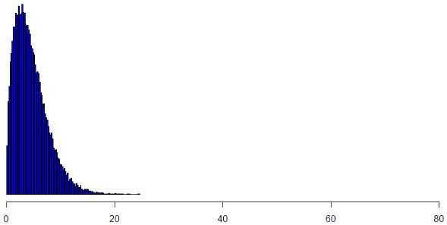
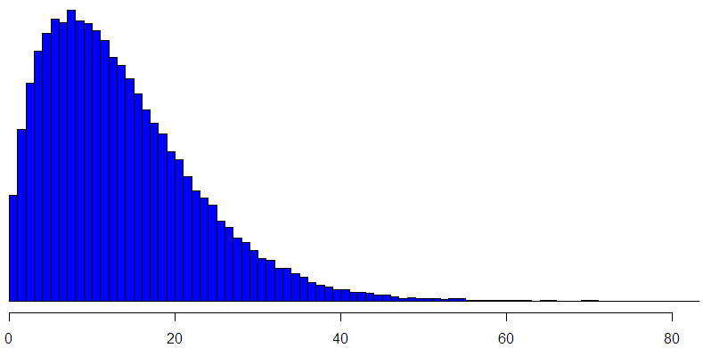
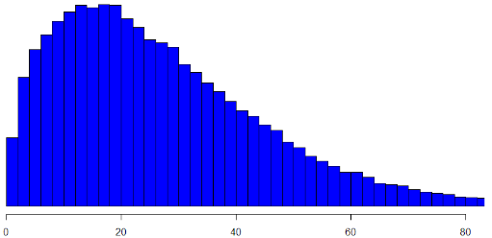
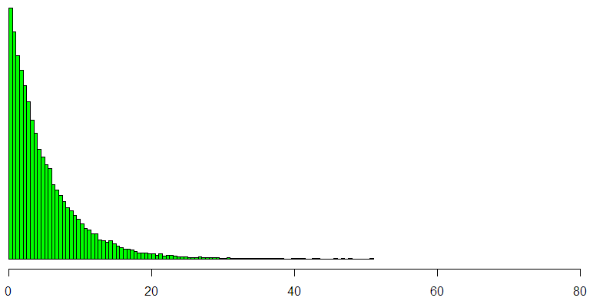
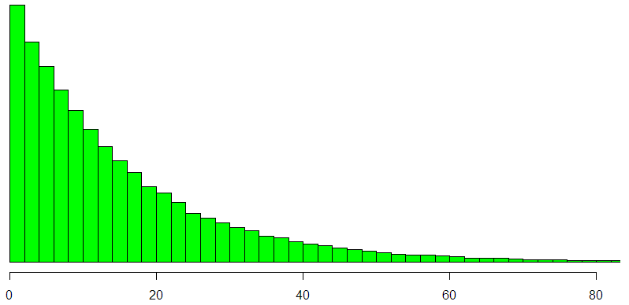
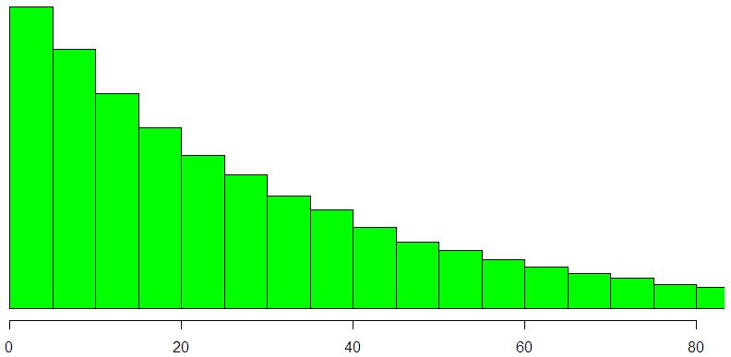
Shape = 2
Process \ External Factors
Shape = 1.5
Batch Size / Iteration Length
Shape = 1
Scale = 5
< 1 week
Scale = 15
~ 2 week sprint
Scale = 30
~ 1 month
Work Item Cycle Time or Lead Time

Slide 99
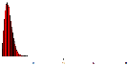
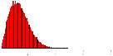

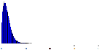





Lean, Few dependencies
Sprint, Many dependencies
Higher work item count
More granular work items
Lower WIP
Team Self Sufficient
Internal Impediments
Do: Automation
Do: Task Efficiency
Lower work item count
Chunkier work items
Higher WIP
External Dependencies
External Impediments
Do: Collapse Teams
Do: Impediment analysis
Paper: http://bit.ly/14eYFM2

